Slide 1
Development of a Smart Wireless Charging System for Robotics
Presenter: SHARMA Milind (55805388)
Supervisor: Dr. Chunhua Liu

Slide 2
Part 1: The Product
1. Background of Smart Wireless Chargers
2. The SmartCharge System
3. Features
Part 2: The Science
5. System Architecture
6. WPT System Design
7. Smart IoT Design
8. Potential
9. Conclusion

Slide 3
Background:
‘Smart Wireless Chargers’

Slide 4
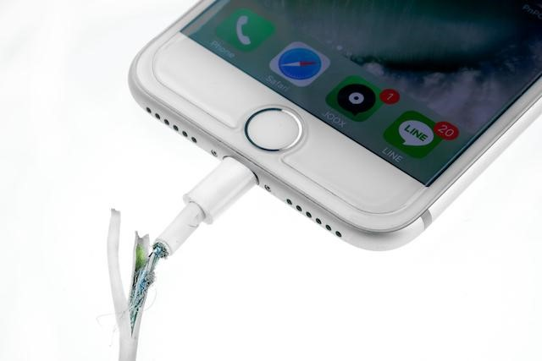
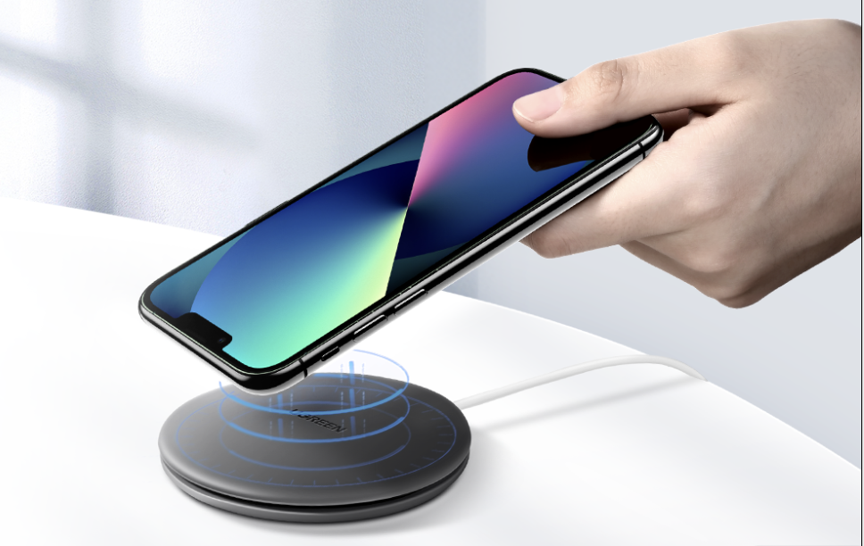
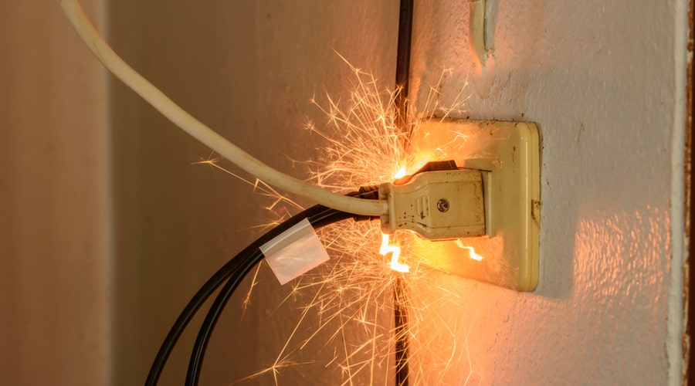
Common Wireless Chargers
Wired Charging
Normal Wireless Chargers

Slide 5
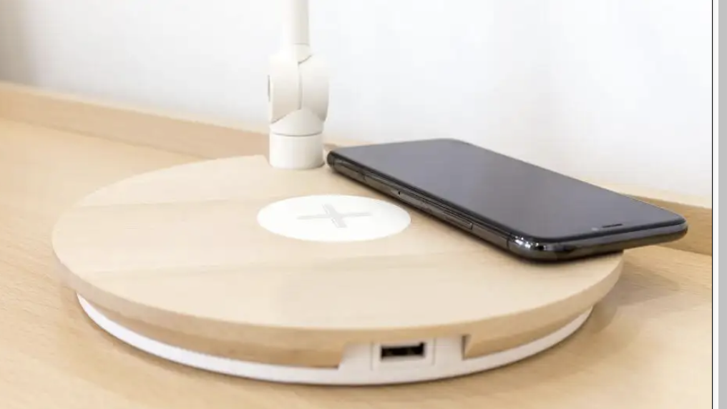
Common Wireless Chargers
No Misalignment Warning
No Monitoring of Charger
Limited Control

Slide 6
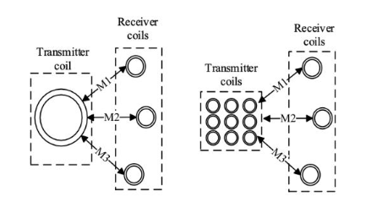
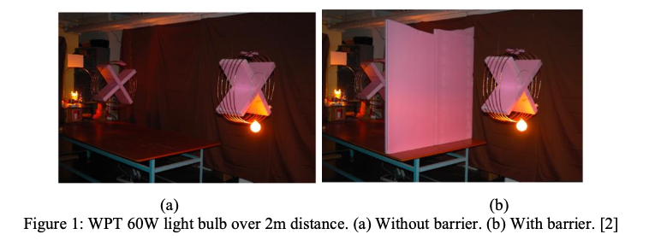
‘Smart’ Wireless Chargers
But is this really a smart device?
Focused on:
Efficient Charging
Coil Topologies
Transmission Distances

Slide 7
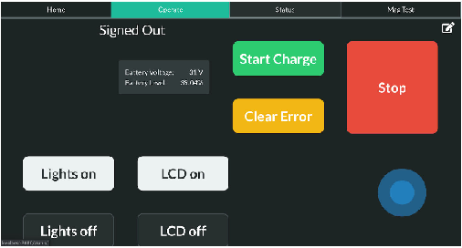
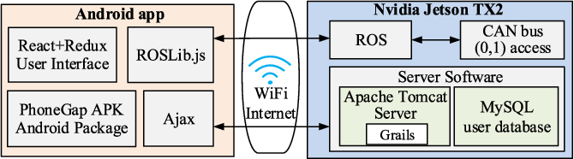
‘Smart’ Wireless Chargers
Existing Research on Smart IoT wireless chargers
Overly complex for IoT architecture
Not a user friendly UI
Source

Slide 8
2. The SmartCharge System

Slide 9
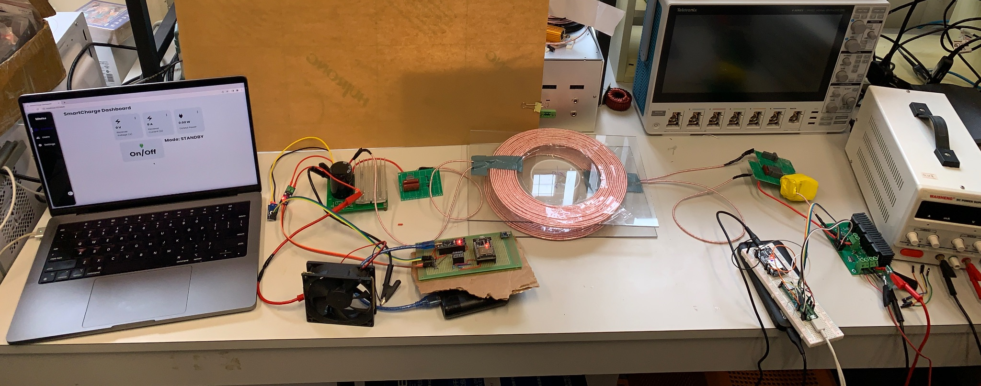
A Truly Smart Wireless Charger

Slide 10
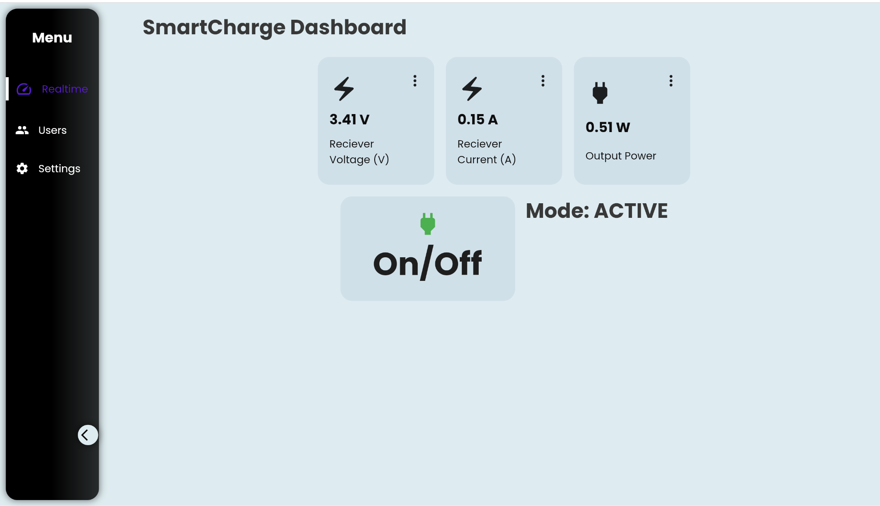
Remote Charge Monitoring and Control

Slide 11
Science and Engineering
WPT System Design Details

Slide 12
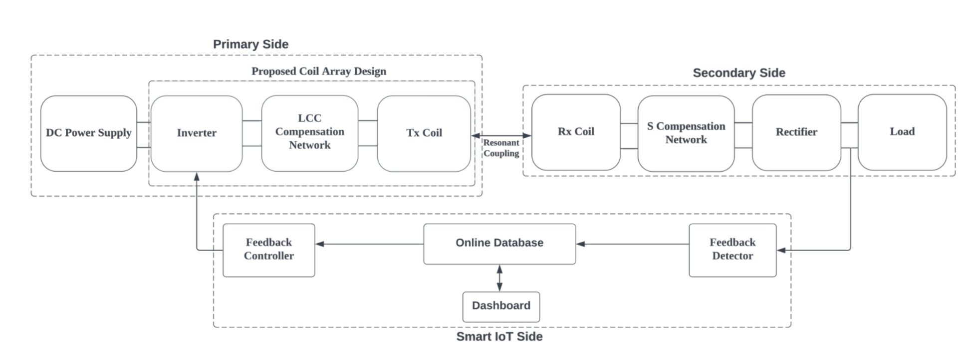
System Architecture
diagram of system architecture

Slide 13
The Inverter
schematic, end product, purpose of it
Energises the primary coil with high frequency signal (100 kHz)
Produces modified square wave

Slide 14
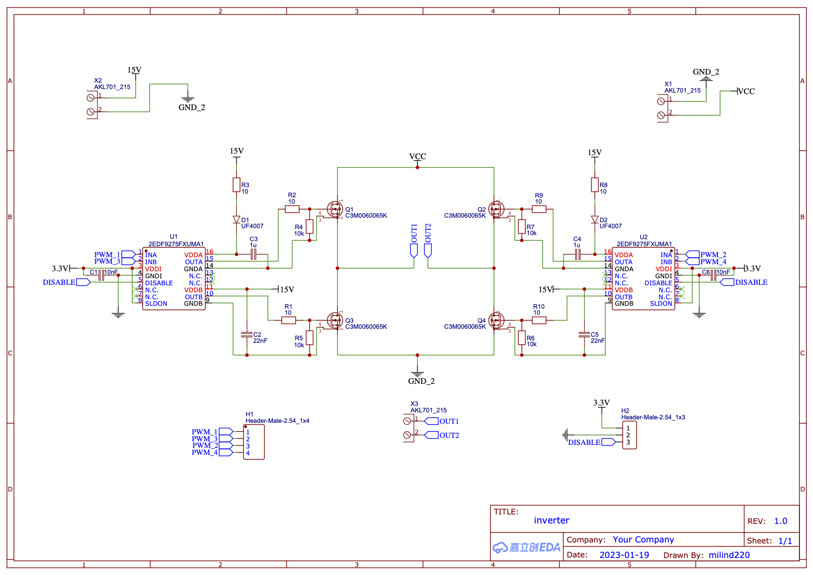
Inverter Schematic
H Bridge Inverter
Bootstrap configuration
SiC Power MOSFETS (C3M0060065K)
Gate driver ICs (Infineon 2EDF9275F)

Slide 15
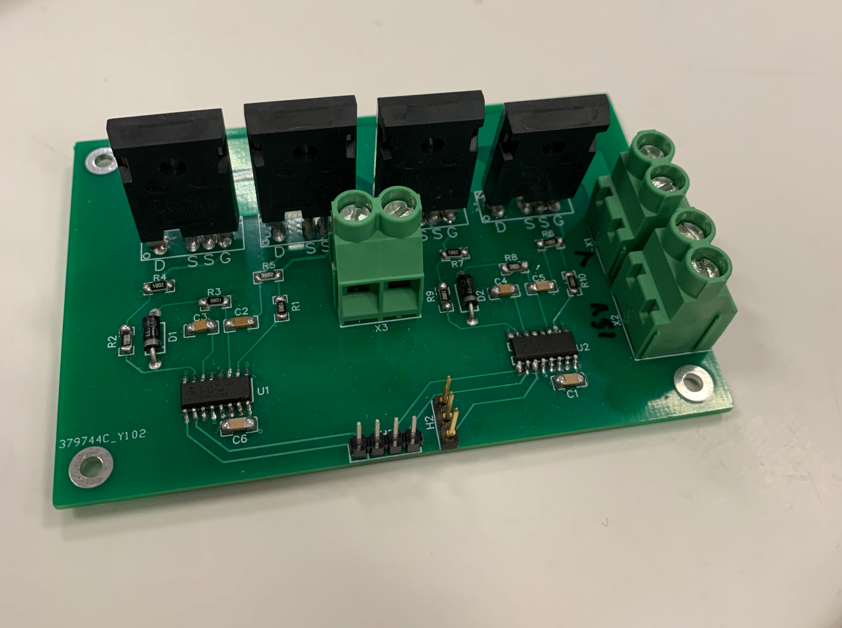
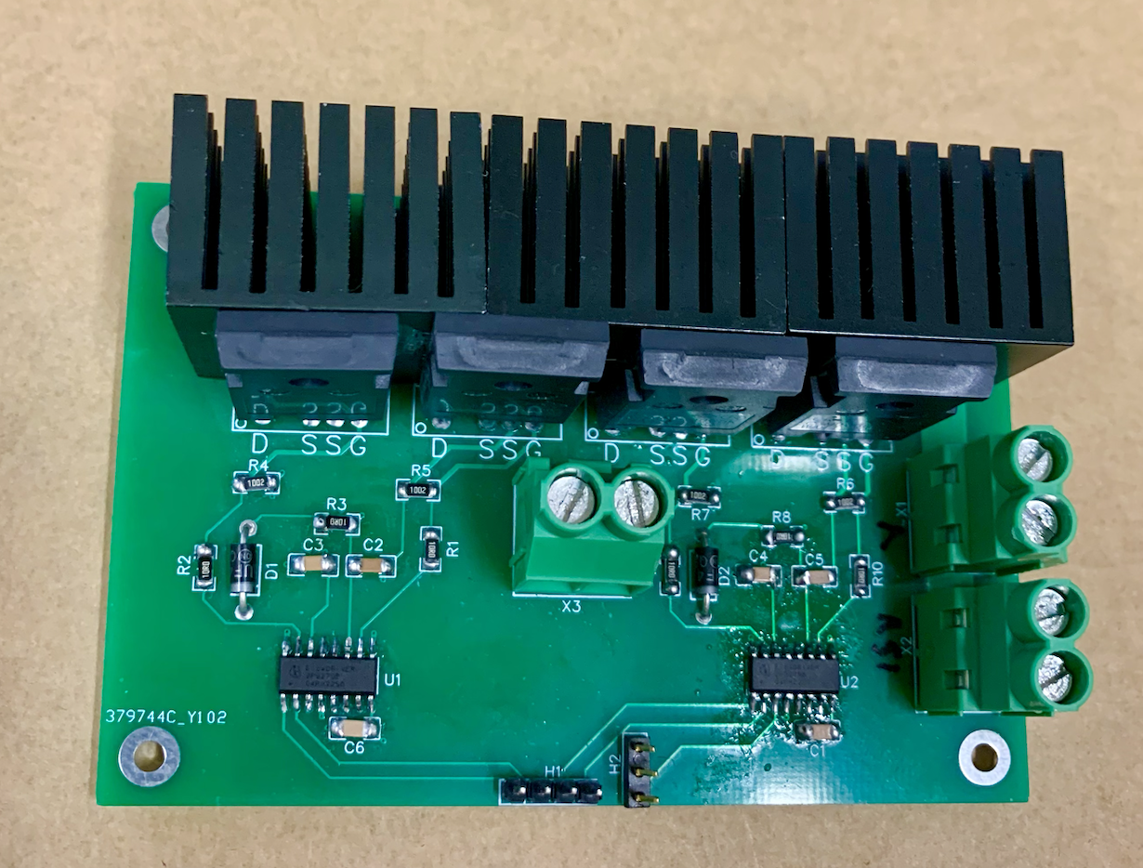
Inverter PCB
Tested at 100 kHz
Tested at 119 W input
Theoretically should be able to handle:
several hundred Watts
several hundred kHz

Slide 16
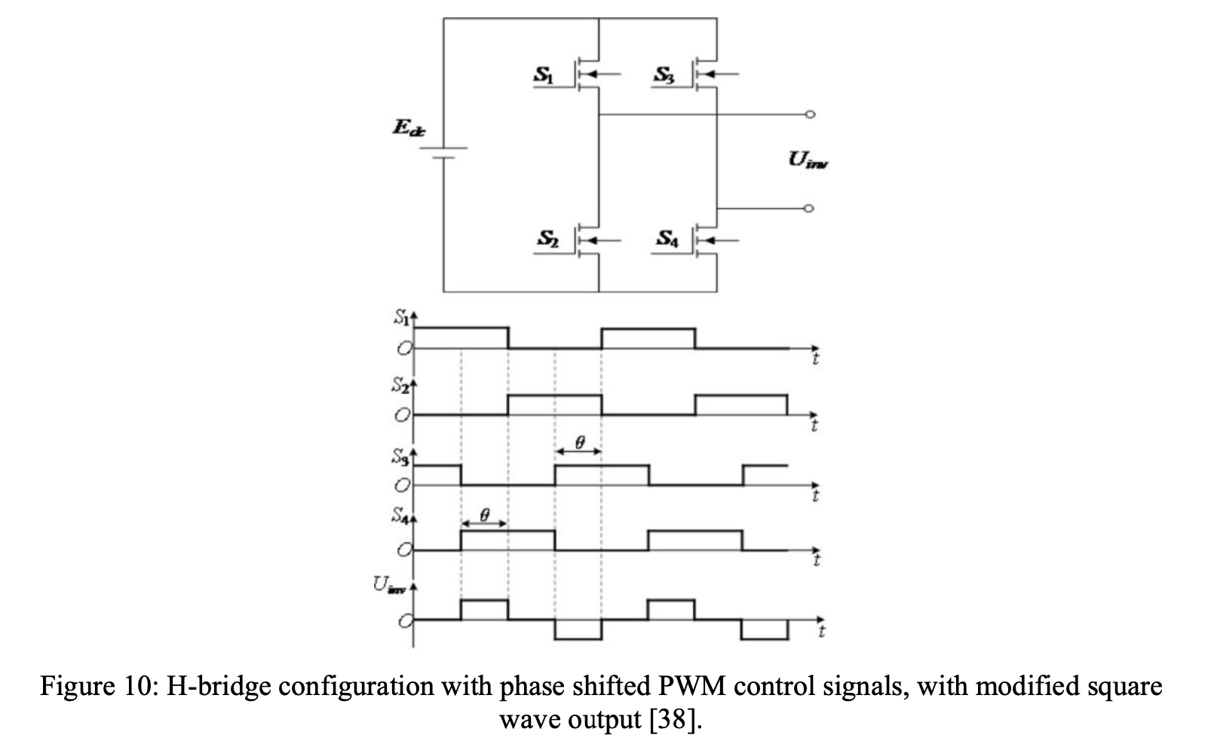
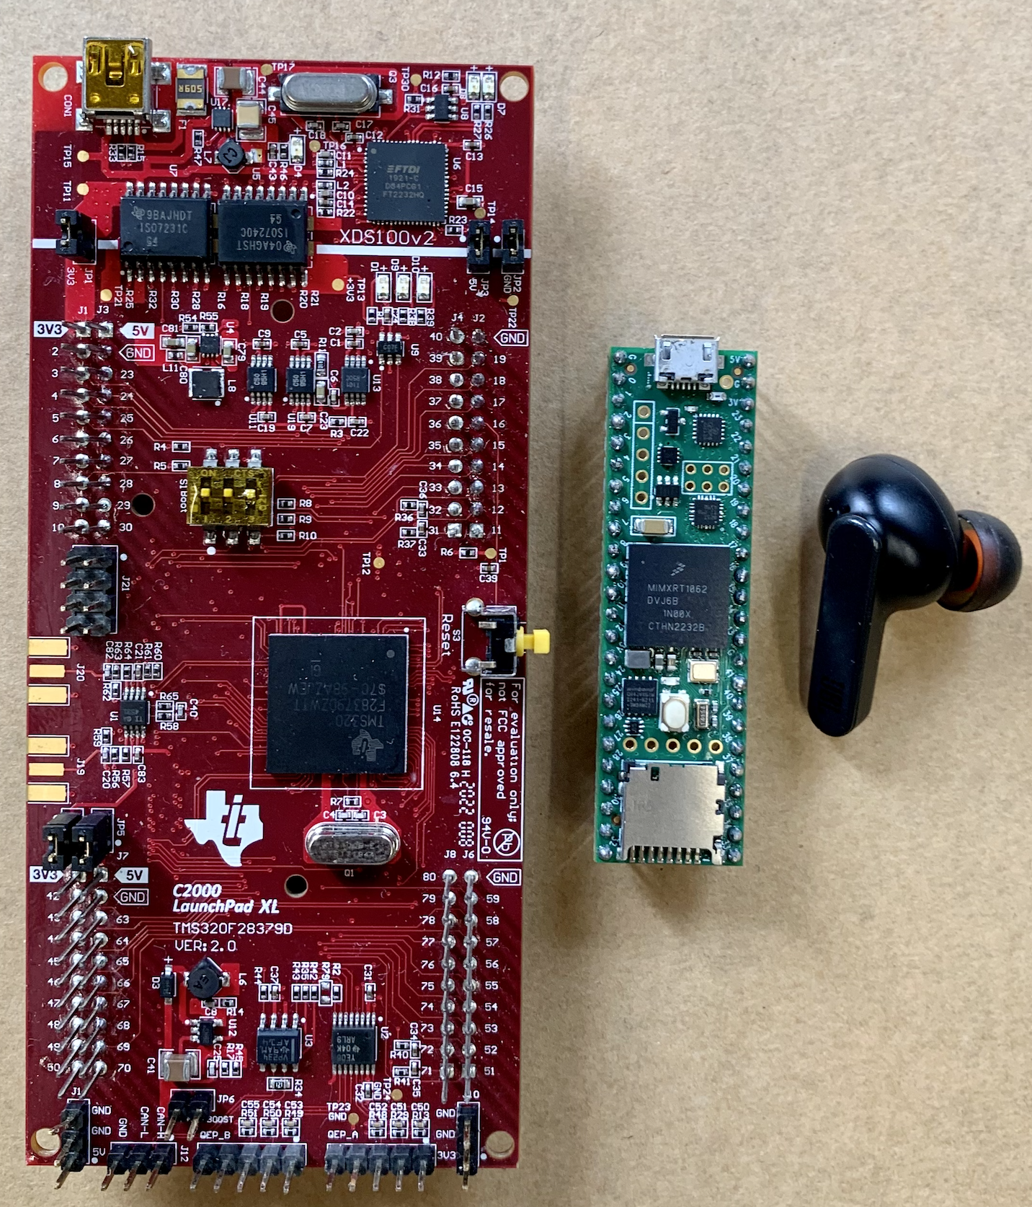
Inverter Controller: Phase Shift PWM
LaunchXL F28379D)
Teensy 4.1

Slide 17
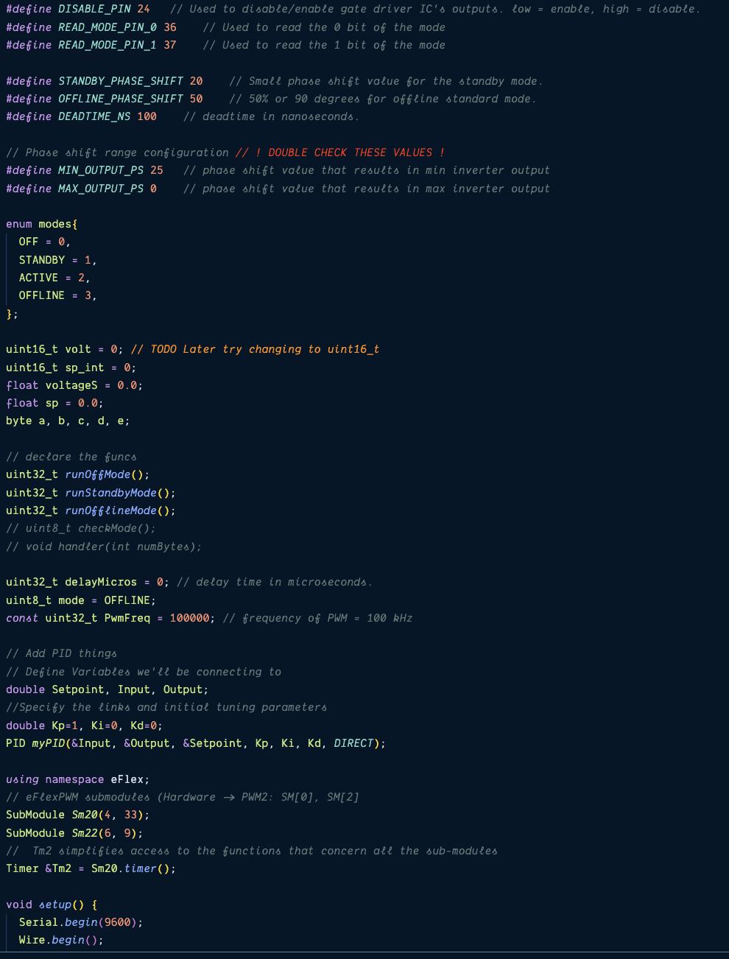
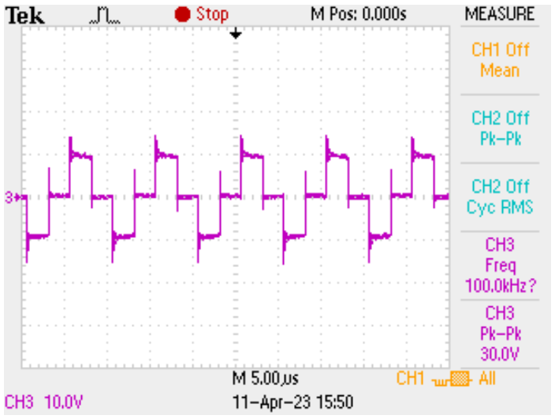
Inverter Testing
Inverter output at 100 kHz, 90 degree phase shift

Slide 18
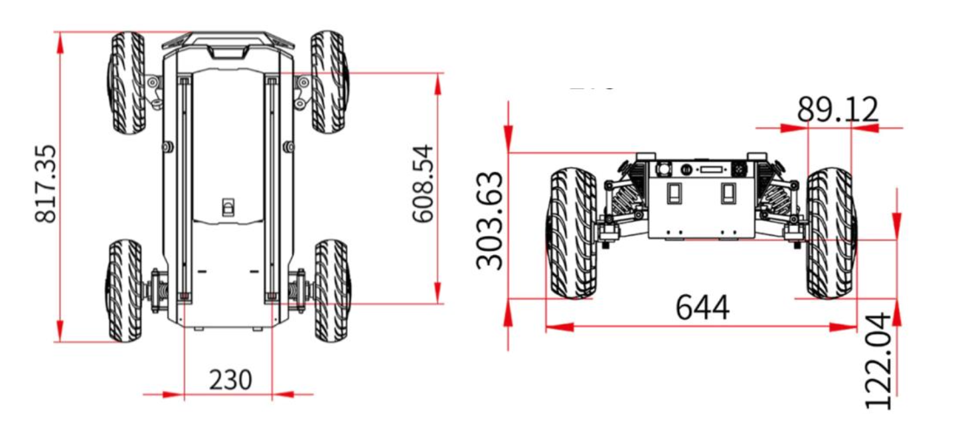
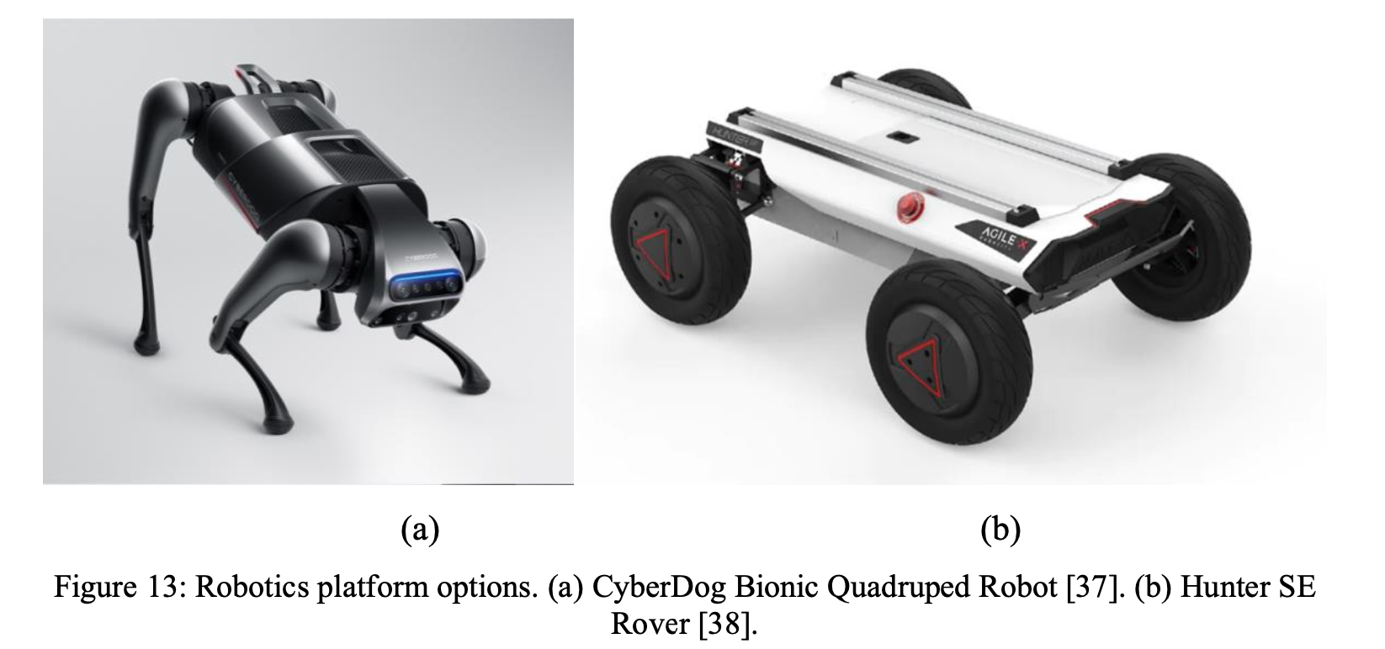
Platform
Hunter SE Rover
Constraint: 23 cm diameter

Slide 19
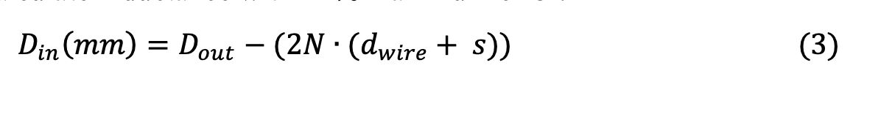
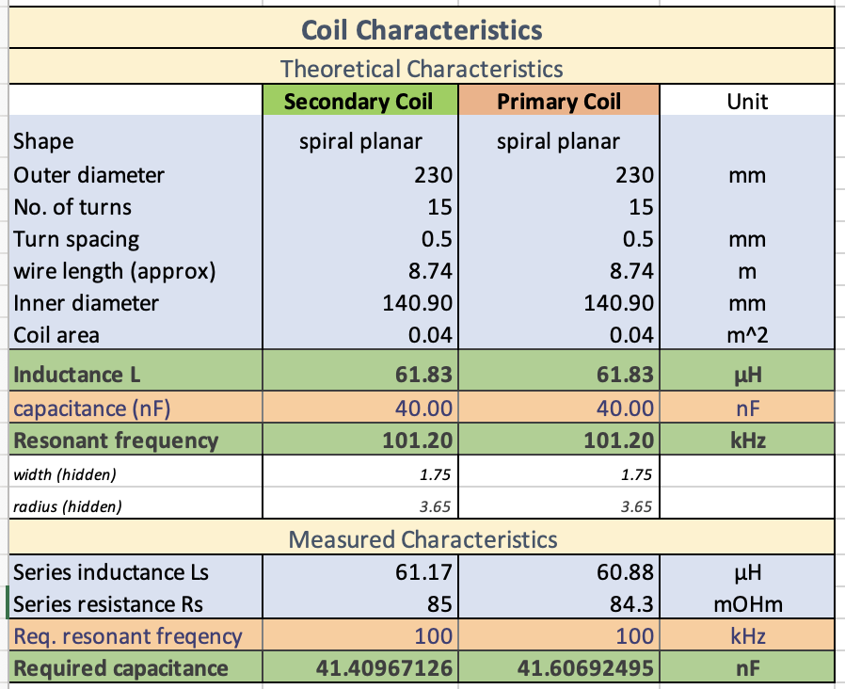
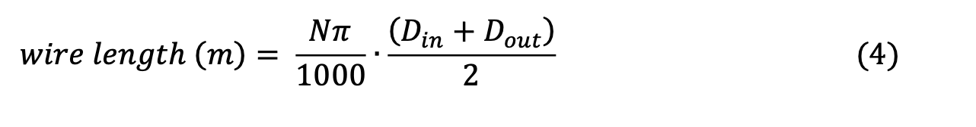
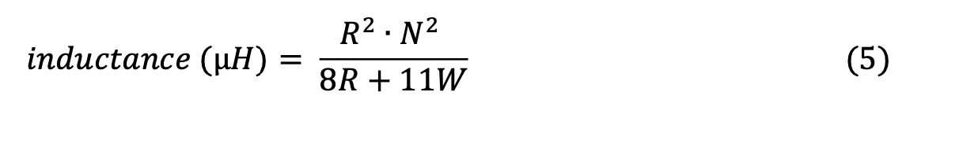
Charging Coils
Coil modelling (simulation)

Slide 20
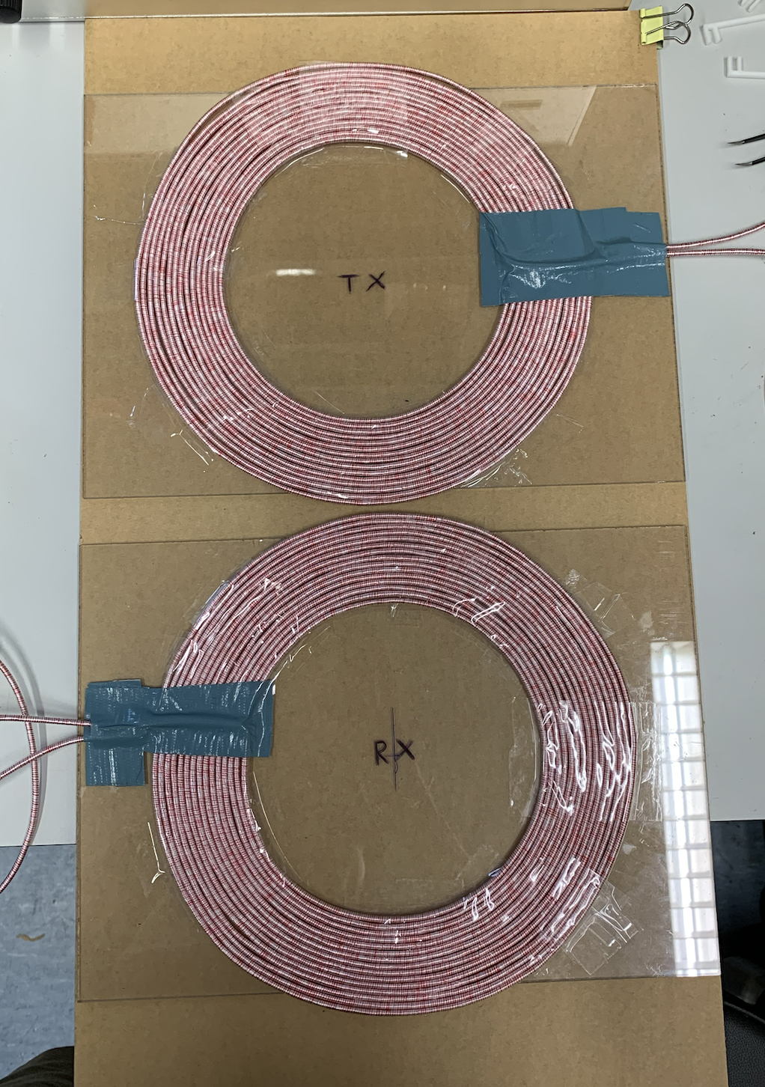
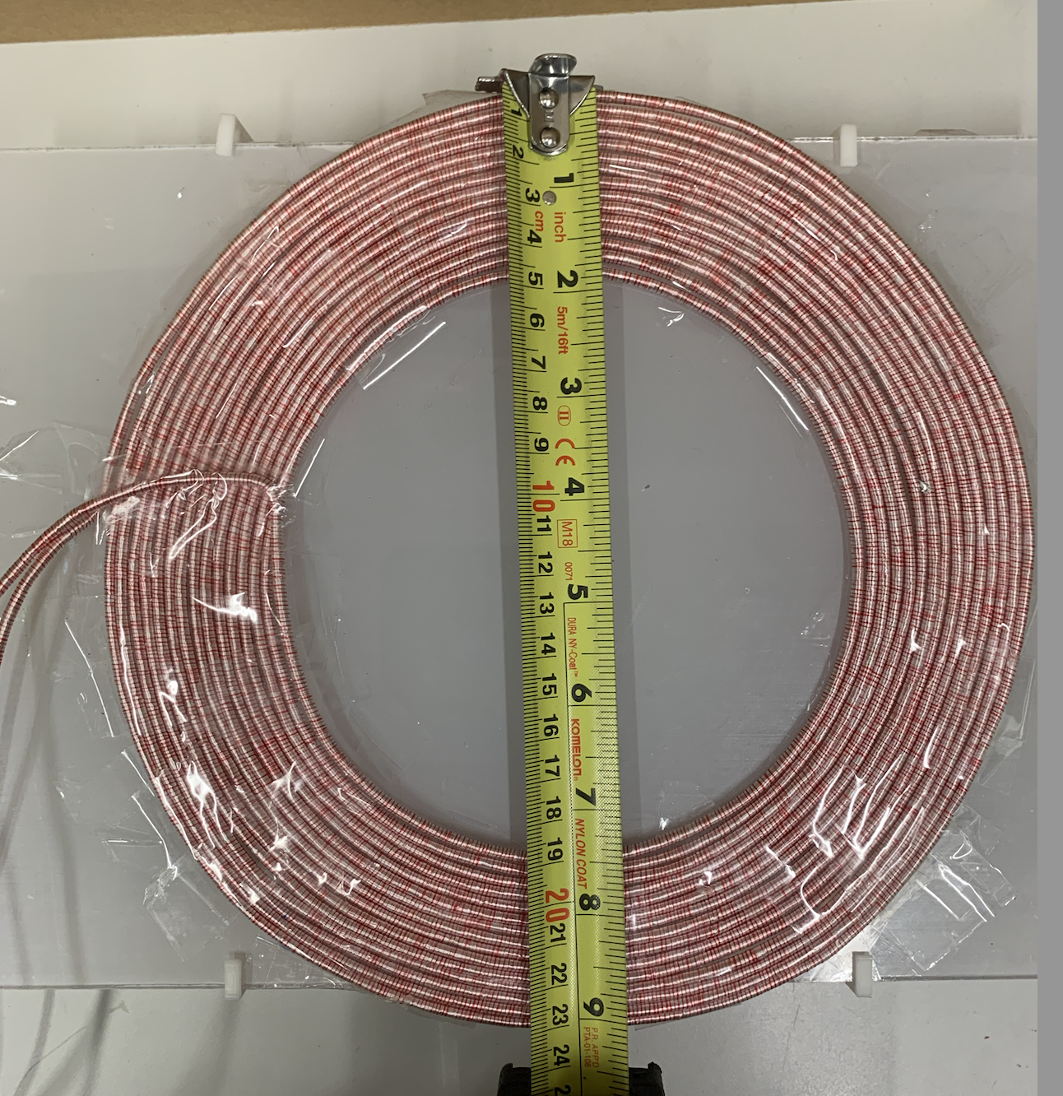
Charging Coils
Circular coils
15 turns
Litz Wire
Lower EMI to surrounding electronics

Slide 21
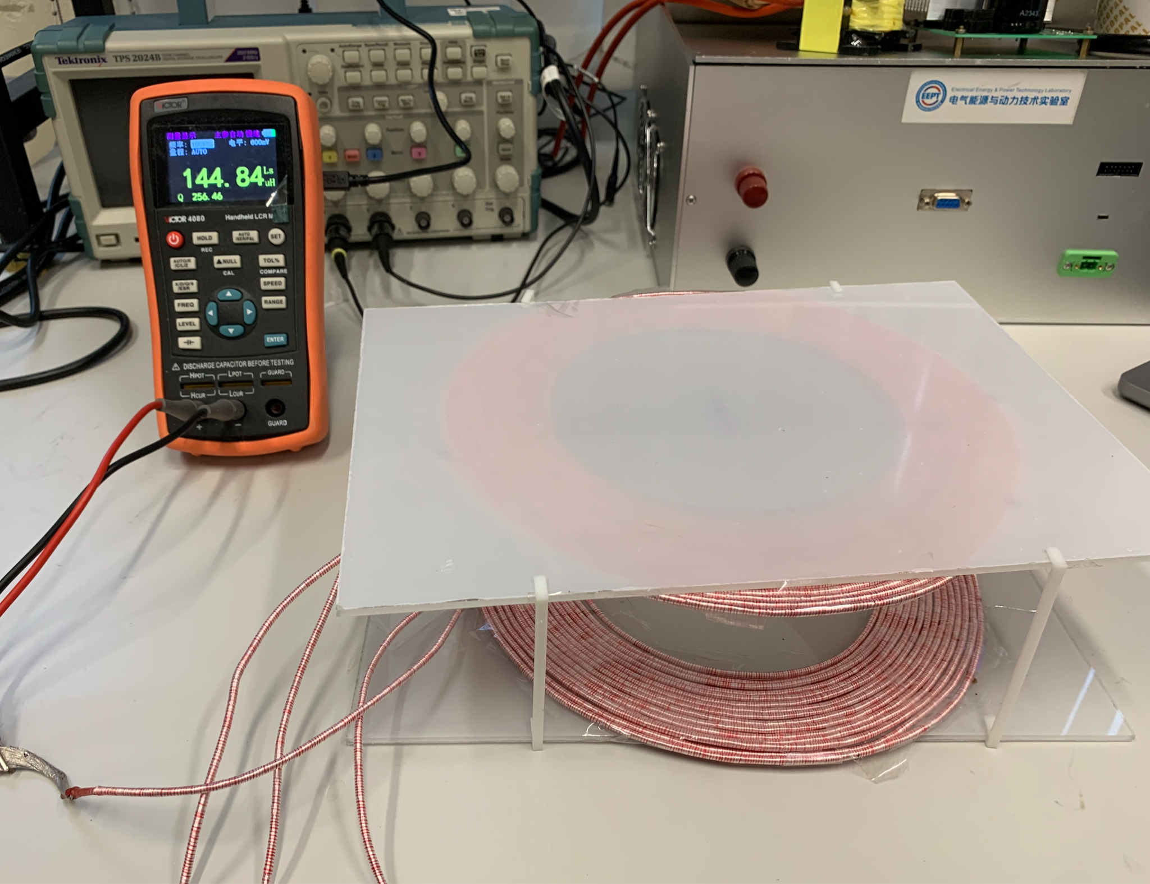
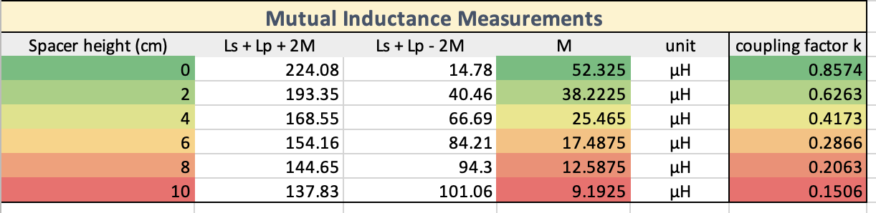
Charging Coils
Mutual Inductance Measurements

Slide 22
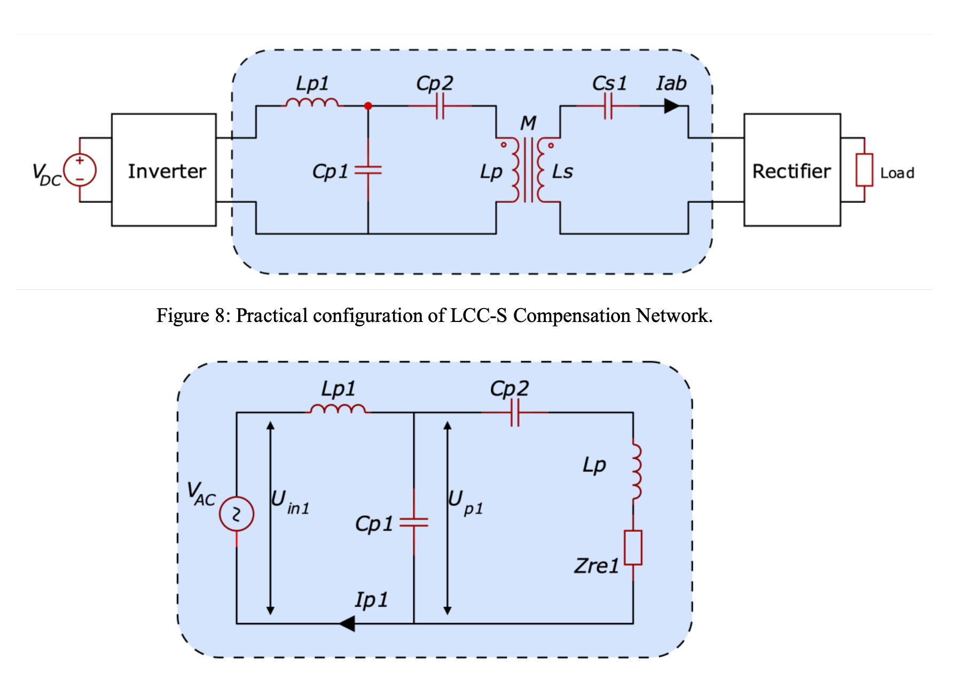
LCC - S Compensation Network
Constant transmitter current
Constant receiver voltage

Slide 23
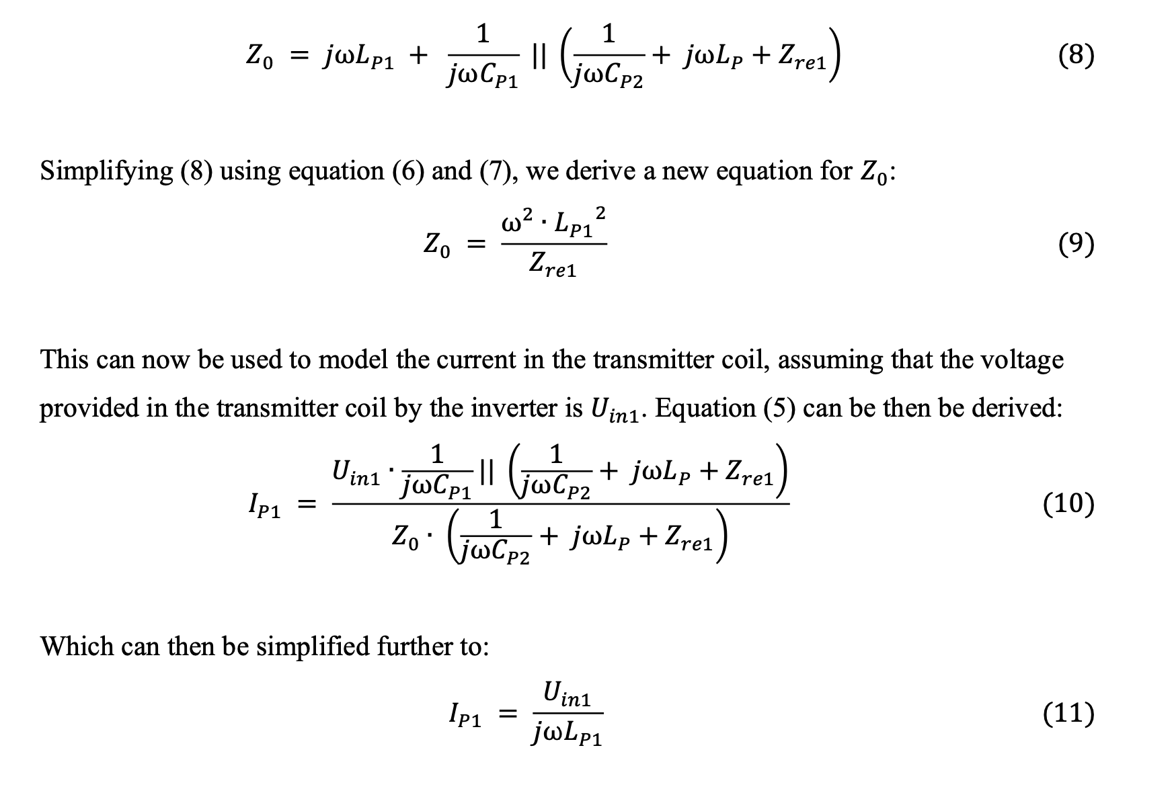
LCC - S Compensation Network
Constant transmitter current
Constant receiver voltage

Slide 24
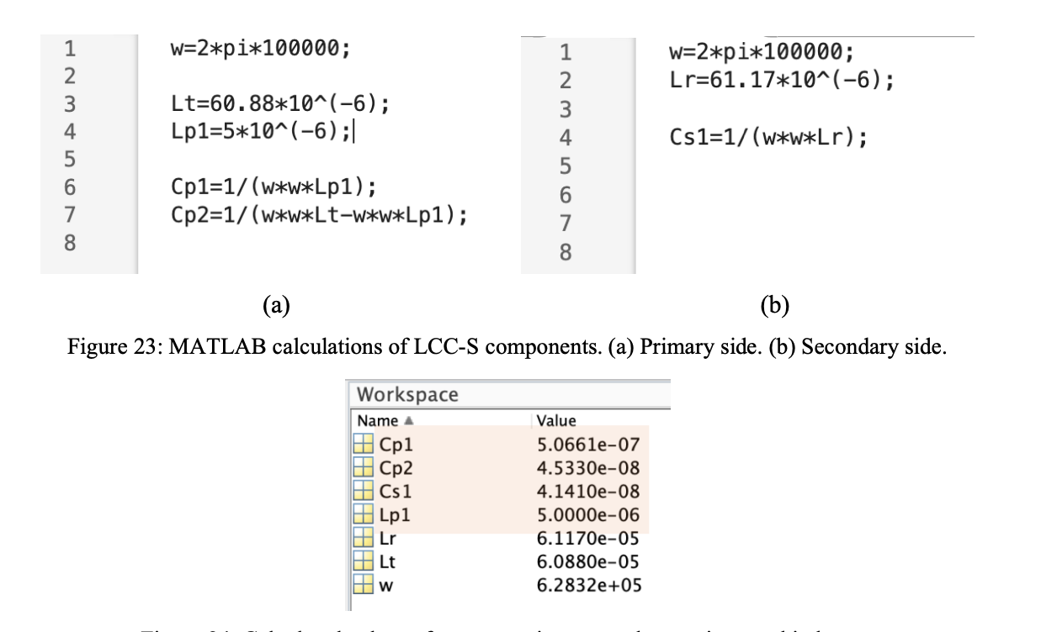
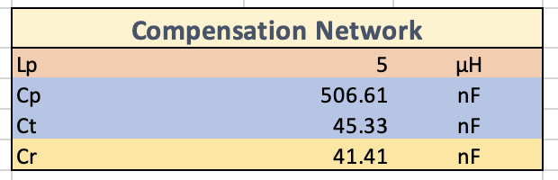
LCC - S Compensation Network
MATLAB to obtain values

Slide 25
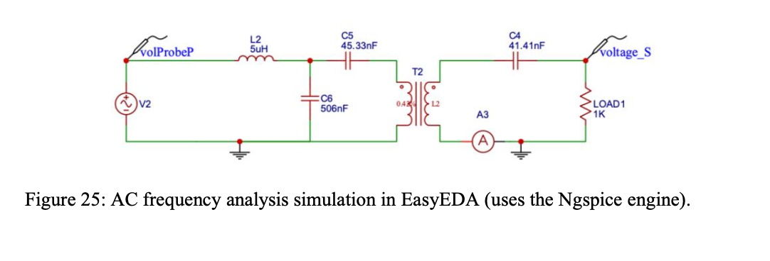
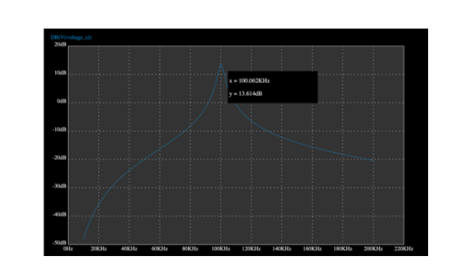
LCC - S Compensation Network
Simulation in nGSpice to confirm values

Slide 26
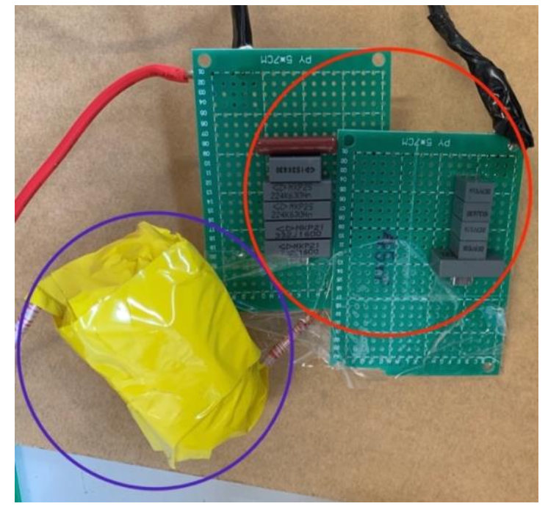
LCC - S Compensation Network
Custom soldered capacitors
Hand-wound inductor

Slide 27
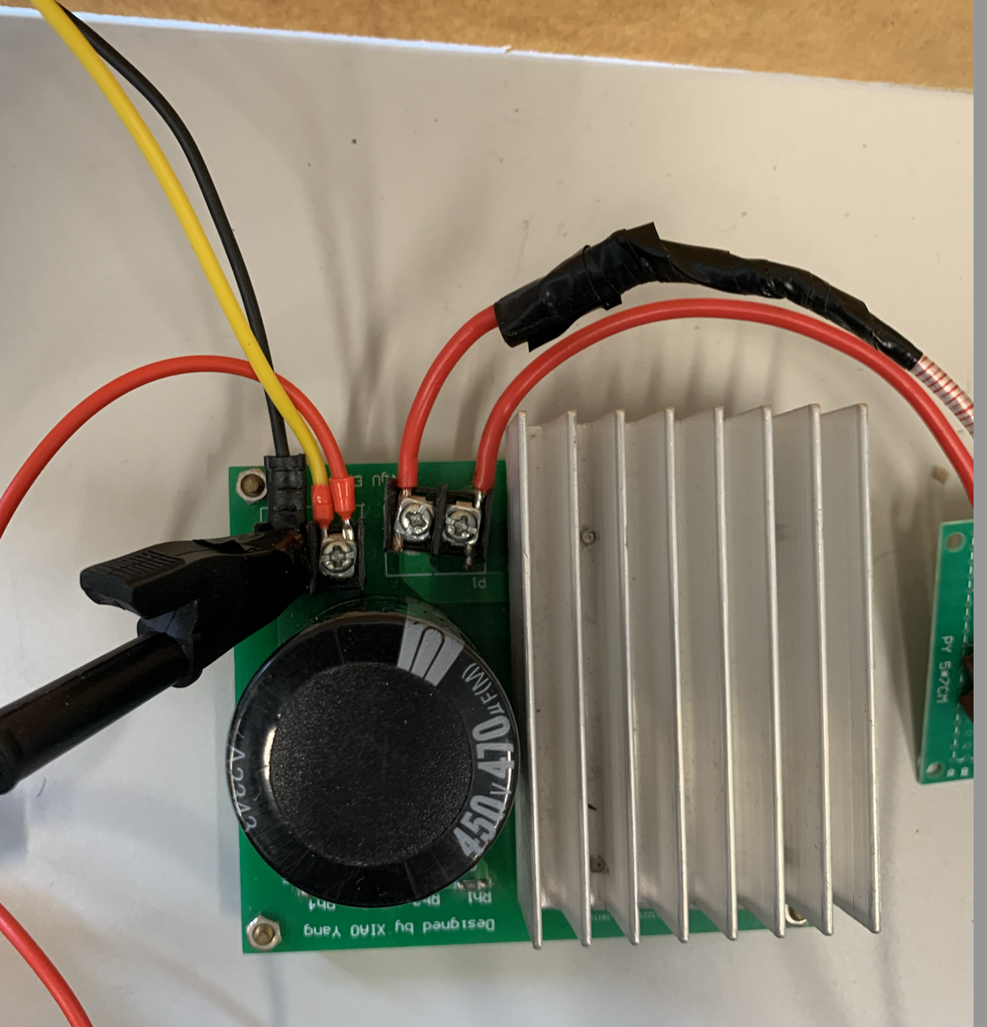
Secondary Side Rectifier
Full bridge rectifier
Converts AC into DC
Off the shelf component

Slide 28
IoT Network Design Details

Slide 29
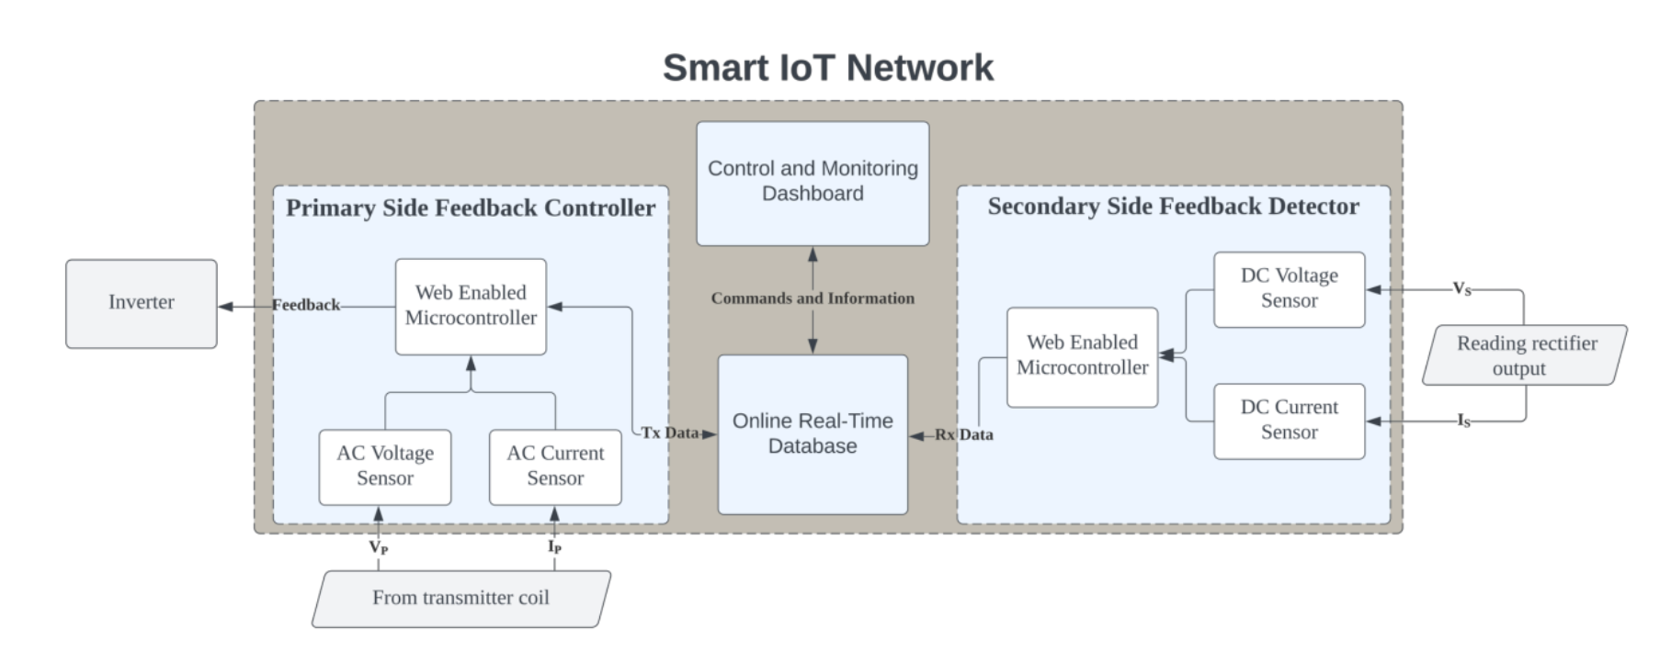
IoT System Architecture

Slide 30
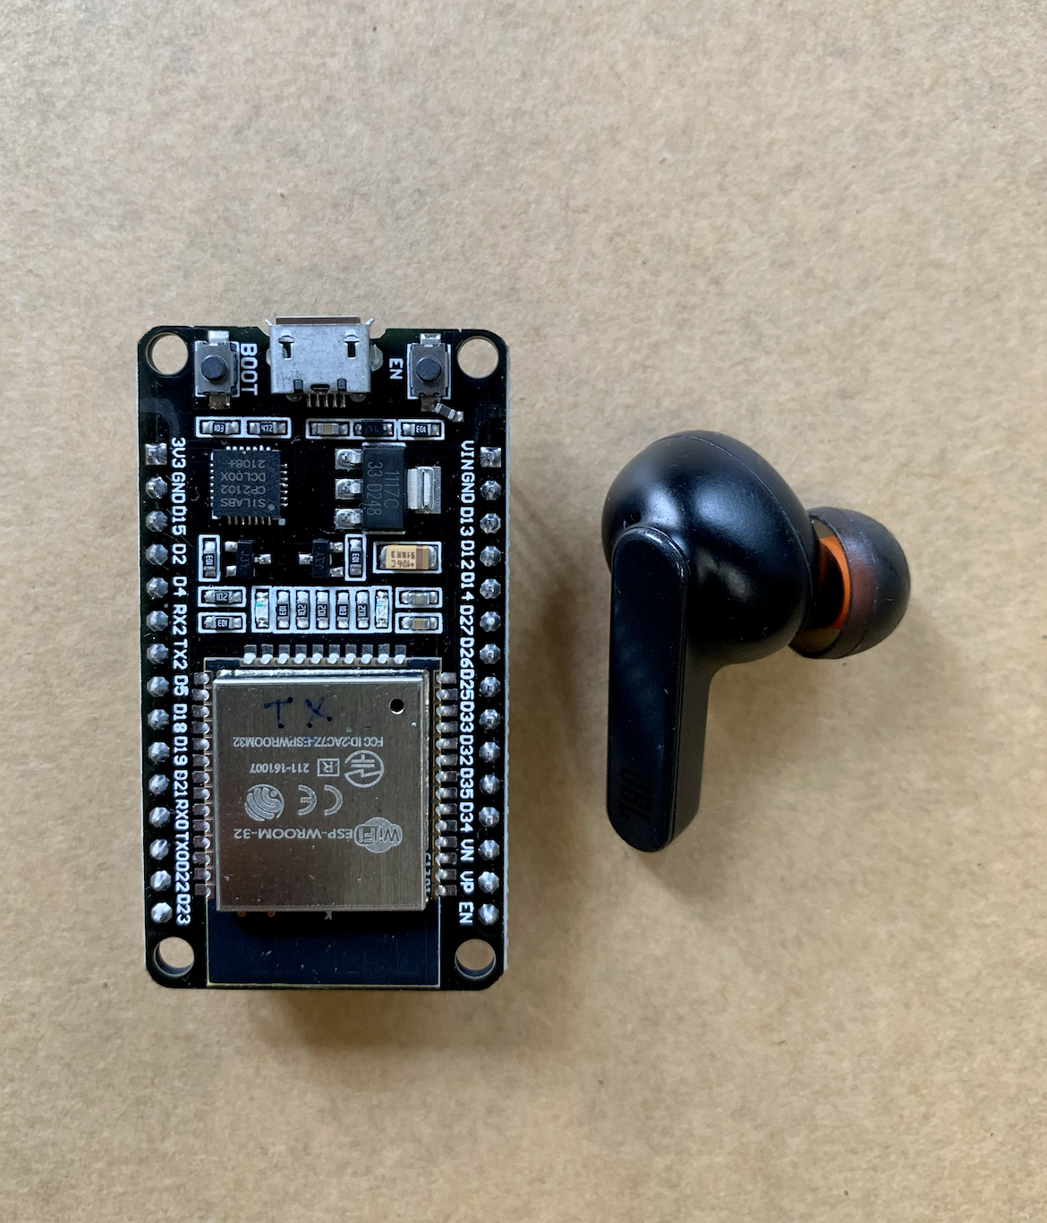
IoT System Microcontroller boards
Bluetooth and Wifi connectivity
32 bit microcontroller
Arduino Compatible
Small size

Slide 31
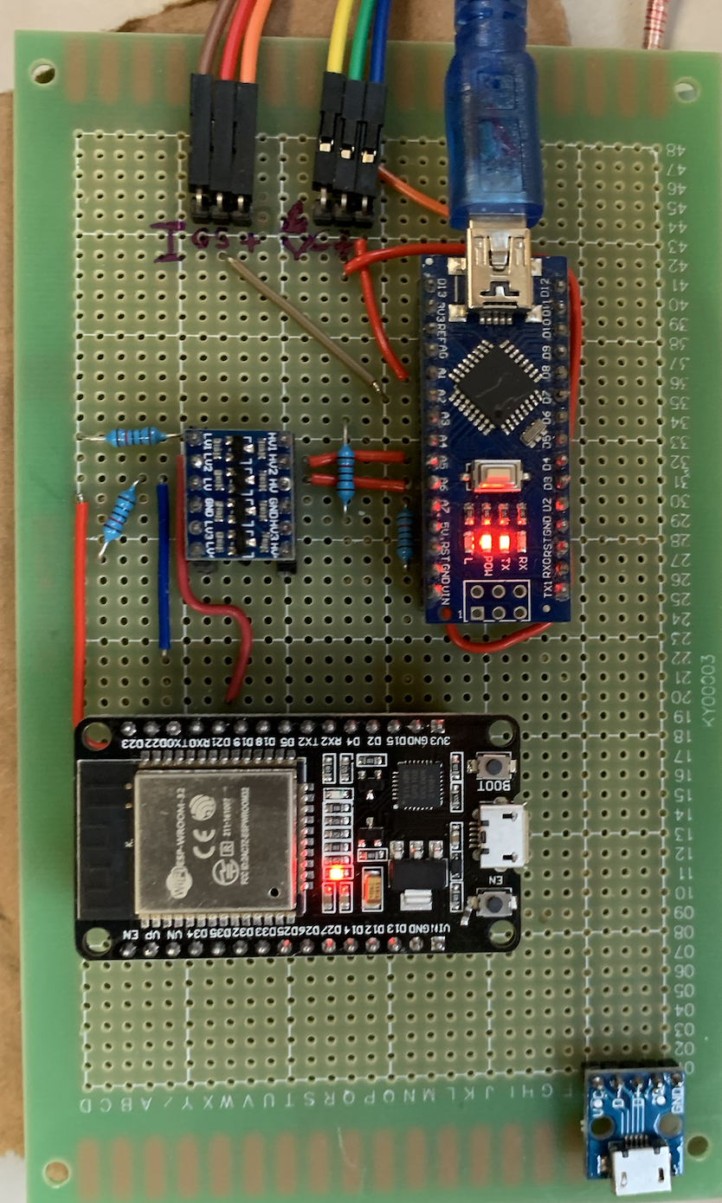
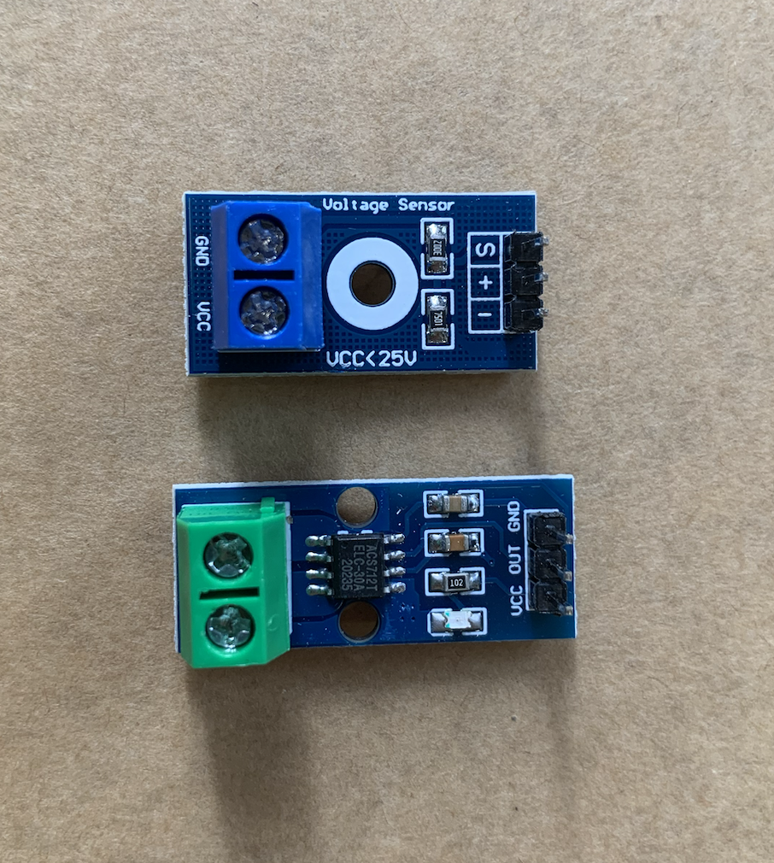
Receiver WebLink
Reads secondary side voltage and current
Sends to database

Slide 32
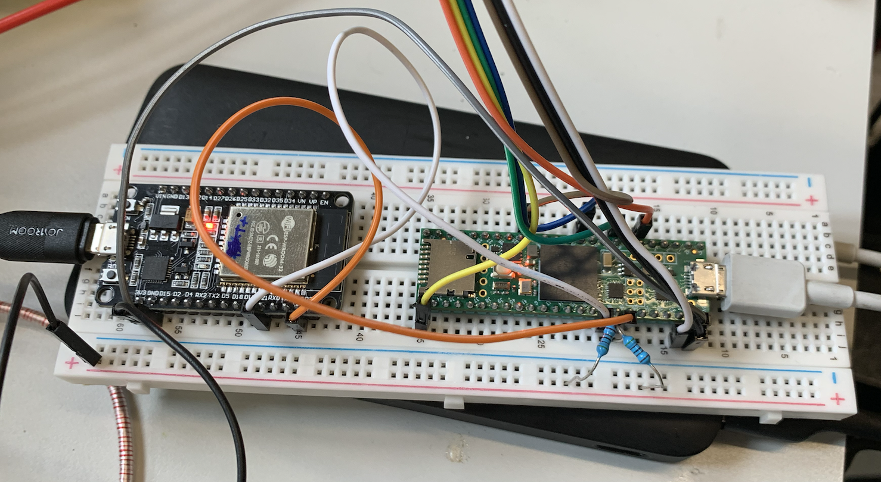
Transmitter WebLink
Gets information from database
Sets mode of the inverter

Slide 33
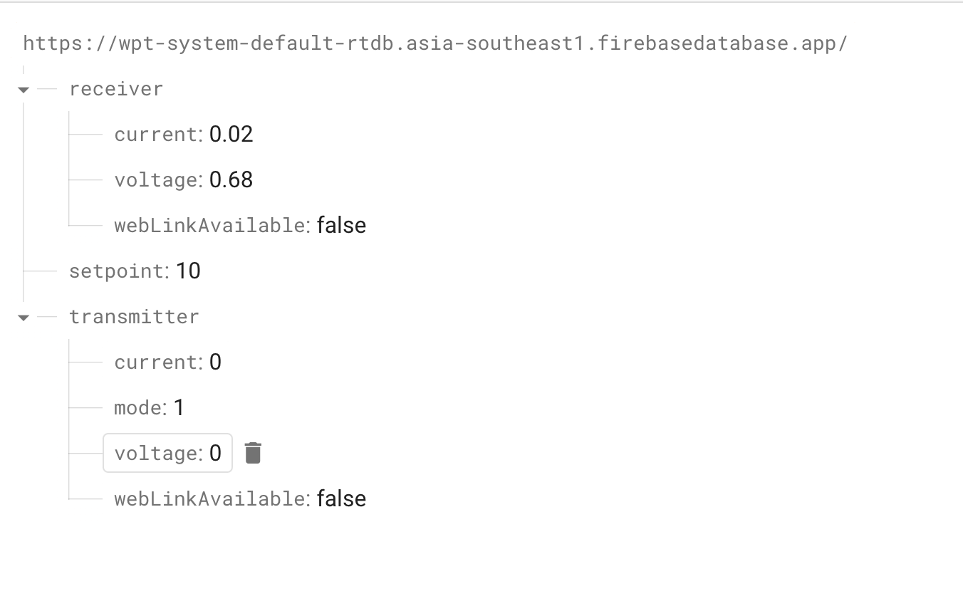
Database
Firebase Realtime database
Continuous stream of updates
Extremely fast

Slide 34
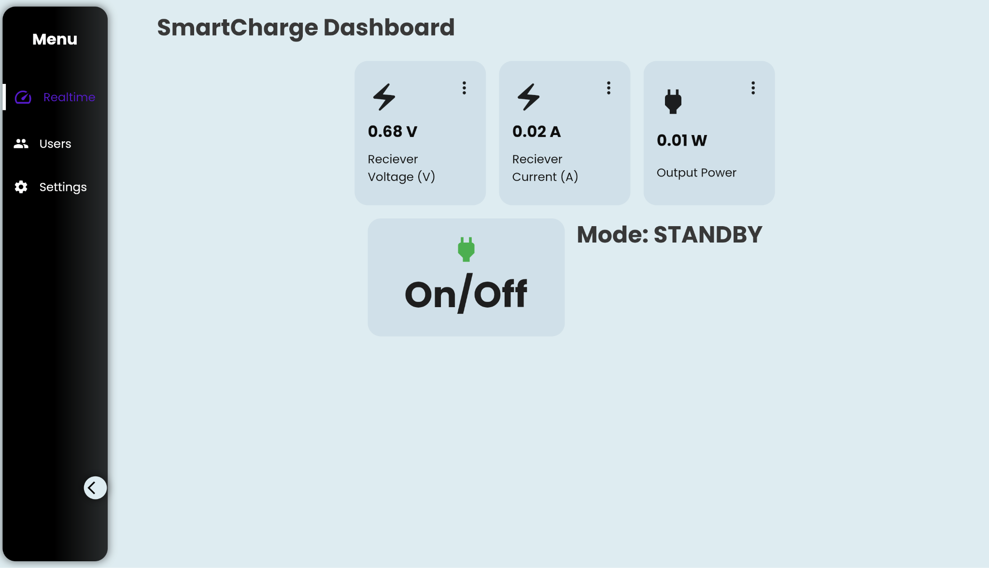
Dashboard
Flutter and Dart
Displays voltage, current and mode.
Real-time updates
On/Off Control button
Web accessible
Cross Platform (iOS, Android, etc)

Slide 35
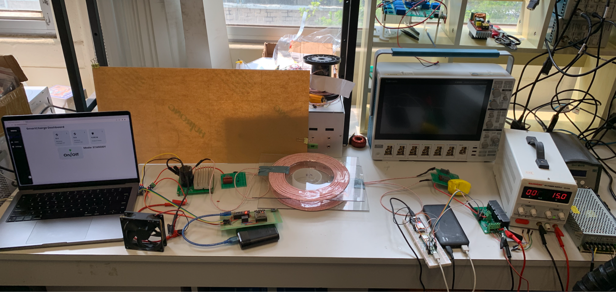
Full System Photo

Slide 36
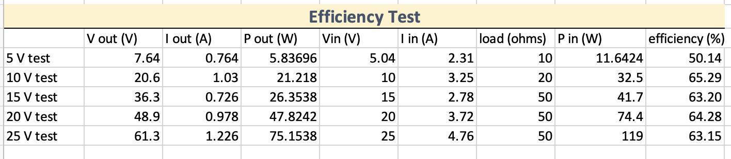
Conclusion
True Smart charging system
Online dashboard for remote monitoring and control
Powerful WPT system customised for AgileX Hunter Rover
Small and compact controller boards and sensors
Max efficiency 65%

Slide 37
The Potential of SmartCharge System

Slide 38
Future Potential
Primary side voltage/current monitoring
Real-time efficiency monitoring
Alignment monitoring
Multiple charger management

Slide 39
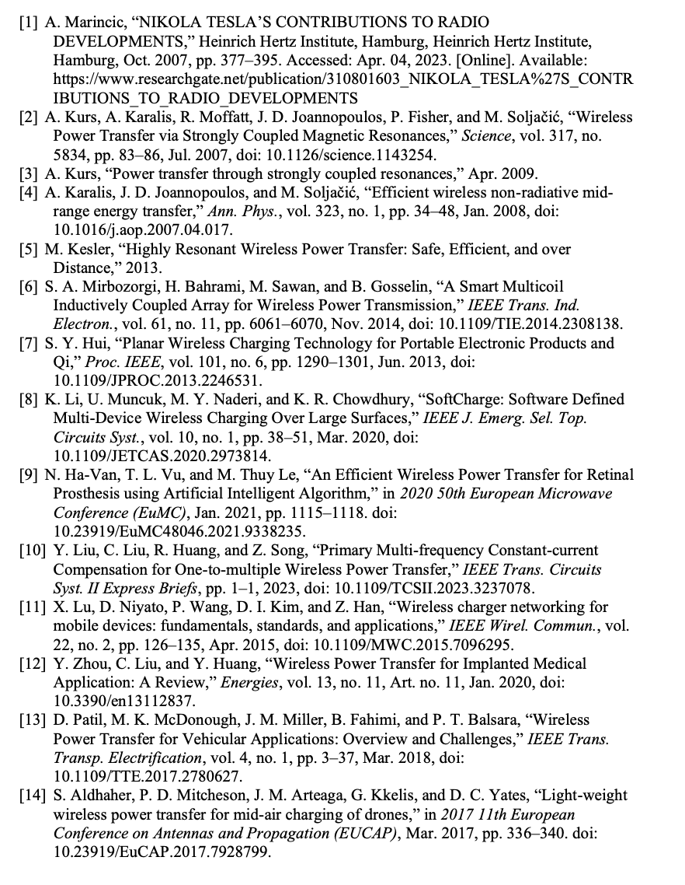
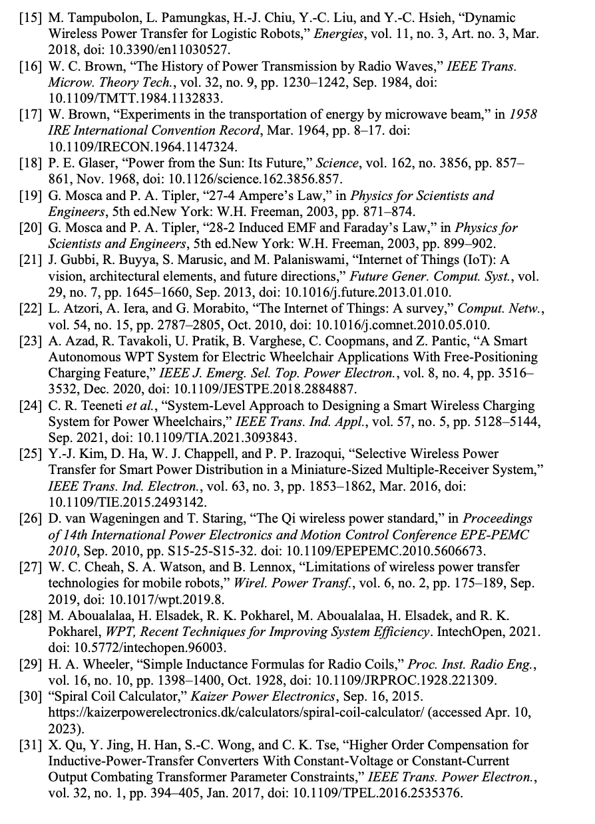
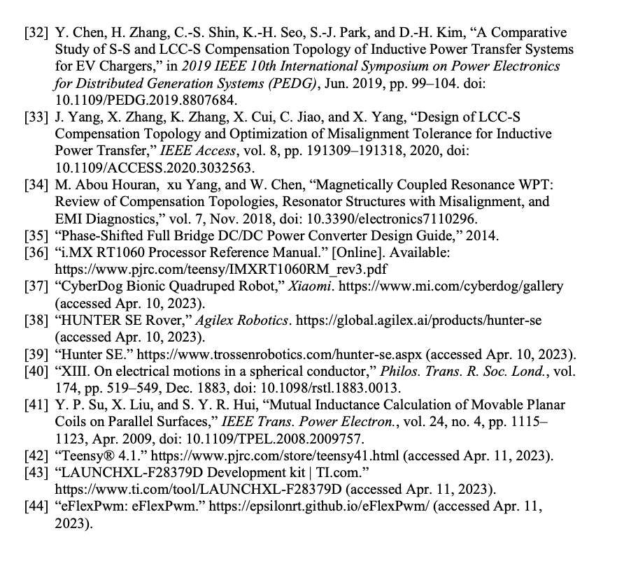
References

